Slide 1
Change, Engagement & Artificial Intelligence
Jo Curkpatrick & Lee Hopkins

Slide 2
Your speakers
Jo Curkpatrick
Lee Hopkins

Slide 3
Tonight
What are you doing to support the successful adoption of AI by your organisation, employees and other stakeholders?
How do you engage people when there is fear of losing a job or power?
How do you embrace the change of AI disruption when there are so many unknowns?

Slide 4
What is AI?

Slide 5
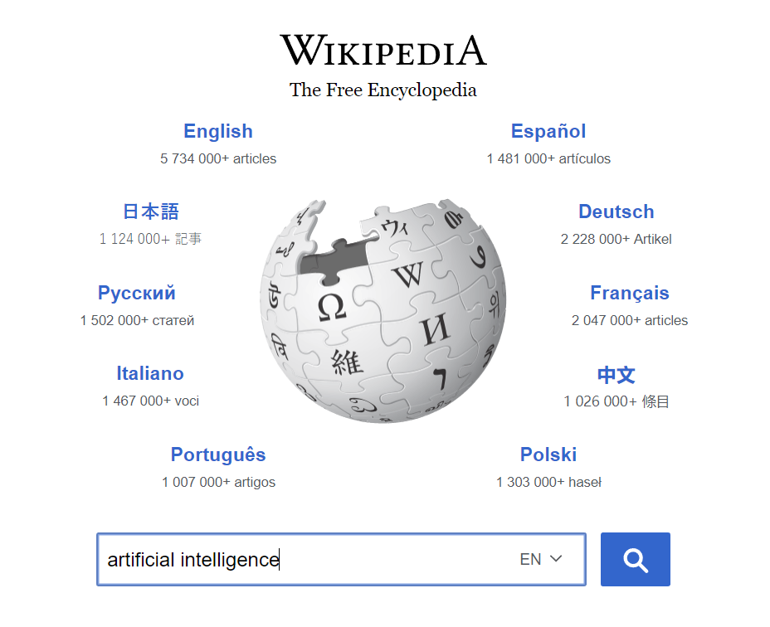
In computer science AI research is defined as the study of "intelligent agents"
any device that perceives its environment and takes actions that maximise its chance of successfully achieving its goals.
Colloquially, the term "artificial intelligence" is applied when a machine mimics "cognitive" functions that humans associate with other human minds, such as "learning" and "problem solving"

Slide 6
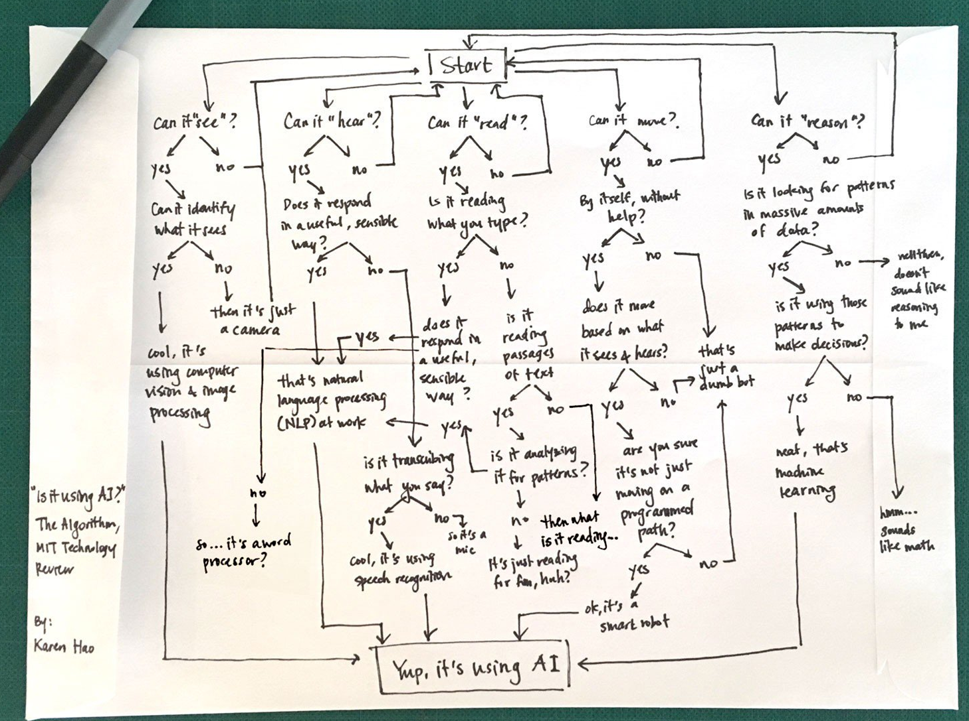

Slide 7
Machines behaving intelligently

Slide 8
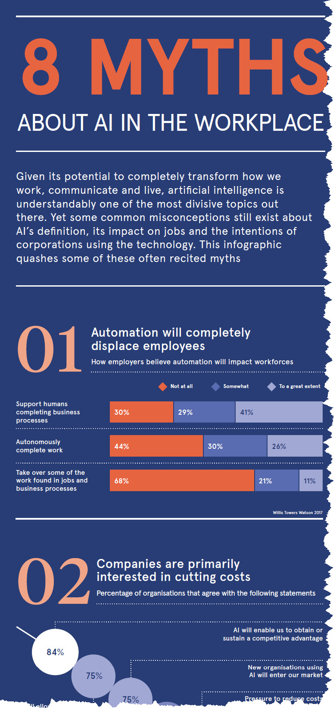
AI Myths
Automation will completely displace employees
Companies are primarily interested in cutting costs
AI, machine-learning and deep learning are all the same thing
Automation will eradicate more jobs than it creates
Source: visualcapitalist.com/debunking-8-myths-ai-workplace/

Slide 9
AI Myths
Robots and AI are the same thing
AI won’t affect my industry
Companies implementing AI don’t care about me
Higher productivity equals higher profits and less employment
Source: visualcapitalist.com/debunking-8-myths-ai-workplace/

Slide 10
AI and its impact

Slide 11
AI and its Impacts

Slide 12
Communication and engagement – What does AI mean for professional communicators?

Slide 13
AI will
Know us better than ourselves
Know our audience better than we do
Create content better than we can
Distribute content better than we can

Slide 14
Human input remains critical - In a world of increasing automation our ability to facilitate real human connection becomes even more important
Notes:
In a world of increasing automation we need to facilitate connection, empathy and relationships
AI and machine learning are still transactional, not conversational, a medium between humans, but still involve the human communicating.
In ensuring the TONE is right
To make the MESSAGE appropriate
To keep an eye on values and ethics – even how our AI is dealing with other AI, and to intervene

Slide 15
What communication professionals are doing now Please share your stories
Notes:
Tell us about practical applications you know about
Tell us about your concerns?
•As a manager
•As a communicator
•As an employee

Slide 16
What we can do to facilitate successful AI implementation
Be part of a community of excellence
Align with HR, IT and marketing
Identify advocates
Review your comms strategy
Talk the talk, walk the talk
Be thoughtful, be human

Slide 17
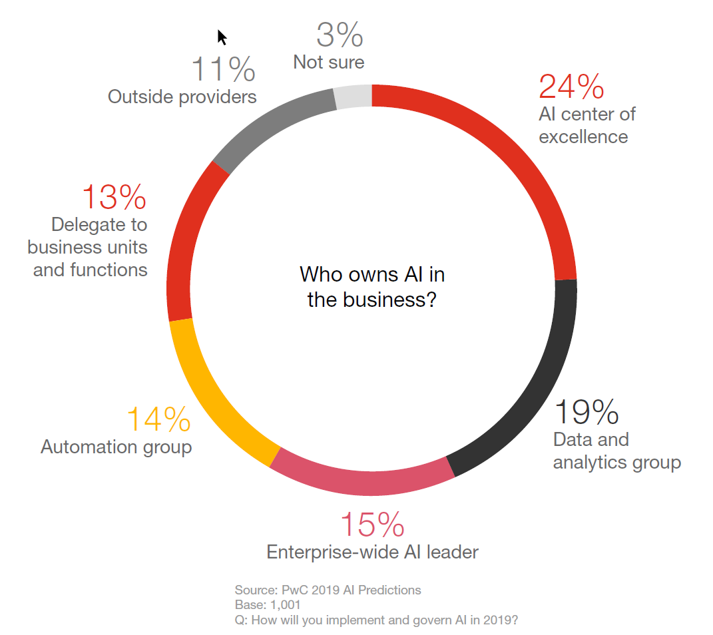
Notes:
PwC put this graphic together to show how organisations are thinking about implementing and governing AI.
As they say:
When AI initiatives begin with AI specialists, they sometimes struggle to gain broad traction. When they come from the business side, projects may have a limited focus may not take full advantage of the technology. In both cases, isolated teams may create duplicate—or incompatible—efforts.
Their answer is oversight from a diverse team that includes people who have business, IT and specialised AI skills and represents all parts of an organisation. You need to be disciplined, creating an organisational structure that crosses functions and enables you to establish a clear AI strategy.
BTW PwC has a Centre of Excellence

Slide 18
A Community of Excellence
AI skills, Training Recruitment
HR, people, culture and change
Ethics and tone
Be thoughtful & human
Marketing, brand, customer service
Stakeholders & advocates
Review messages, comms strategy
Communication and engagement
Technology Data analytics
Business strategy
IT
Strategy and Planning
Notes:
Our framework is aimed at how we might help our own organisations and ensure that as communication professionals we are at the table. A one-stop shop for all things AI.
Link with HR, IT, Marketing, Strategy & Planning, Customer Service
Build skills in data, analytics, IT

Slide 19
What can we do to facilitate successful implementation of AI?
Think about the rules, our Code of Ethics
Be prepared to learn or retrain and ensure your employees understand
Start the conversation, we have an obligation
Enjoy what AI can do to make our jobs easier and faster
Notes:
Where once we were being encouraged to better understand the business, finance and strategy. Now we need to consider improving our knowledge and understanding of machine learning and in particular – statistics, data science – the quantitative stuff. Maybe even programming.
Your mission, your imperative, is to be managing the machines more than being managed by them. By embracing machine learning and AI, by learning what it can do, what outcomes you should demand, and what skills you need to hire for, you’ll be well positioned to adapt to a world in which the majority of the work being done is done by a machine.
AI For Marketers: An Introduction and Primer

Slide 20
AI tools What is out there

Slide 21
Notes:
News release and articles
Share trading
Sport scores

Slide 22
Applied.ai

Slide 23
CIPR

Slide 25
Preparing the communication professionals of the future
Forecasting
Analysis and data management
Thinking skills
Applying emotion, conscience
Notes:
There needs to be a shift in skills
According to Professor Anne Gregory from Huddersfield University in the UK development of a Hippocratic Oath for the professional is being developed

Slide 26
Overcoming the fear and making a start
What will you be doing when you get back to work?
Notes:
The future of work is not one in which the humans do all the work. Instead, the machines will do the work and we will validate that they’ve created the outcomes we want. When they don’t, we’ll help retrain them until they achieve our goals with us.
Either you manage the machines, or the machines will manage you.
Reach out, look around your organisation, help, enable where you can, and lead if necessary
TRY – FAIL – LEARN – SHARE

Slide 27
How did we go?
Try, fail, learn, share: learning opportunities, resources and networking
www.bcr.ai
27
Notes:
Cover off on our offering

Slide 28
Change, Engagement & Artificial Intelligence
Jo Curkpatrick & Lee Hopkins

Slide 29
The new world of work is in the 4th Industrial Revolution, where AI, automation, machine learning, big data analytics and cloud technology and robotics are no longer buzz words or jargon.
They are ‘part and parcel’ of business and industry.

